Slide 1


HTML 5
New APIs - Part 1

Slide 2

HTML5 - New APIs
Course objectives
By completing this course, you will be able to:
Do cross-document messaging
Develop multi-threaded JS applications
Use Drag & Drop features in your web apps
Geolocalize a user of your web apps

Slide 3


HTML5 - New APIs
Course topics
Course’s plan:
Web Messaging API
Web Workers
Drag & Drop
Geolocation

Slide 4

Web Messaging
HTML5 - New APIs

Slide 5

Presentation
Messaging
Allows to talk between two documents
Cross-domain compatible
Secure
Most JavaScript types (strings, integers, JSON, Date, …)
Useful with Web Workers

Slide 6
Talking with iFrames
Messaging
Two ways:
Sending a single message
Punctual message
No context
Defining a channel
Bipolar communication
Message handler defined on each side

Slide 7
Single message - Sending
Messaging
To send a message, you need to:
Define your iFrame tag with a valid src property
Retrieve the iFrame ContentWindow property
Invokes the method
postMessage(message, targetOrigin)

Slide 8
<!-- File: http://origin.com/index.html -->
<body>
<button disabled>Send</button>
<iframe src="http://remote.com"></iframe>
<script type="text/javascript">
var button = document.querySelector("button")
, frame = document.querySelector("iframe")
, i = 0;
frame.onload = function() {
button.removeAttribute("disabled");
};
button.onclick = function() {
frame.contentWindow.postMessage(++i,
frame.src);
};
</script>
</body>
Single message - Sending

Slide 9
Single message - Receiving
Messaging
To read the message in the remote page:
Define a Window.onmessage event handler
Use the MessageEvent object in the handler to
Check the event origin to prevent malicious code
Retrieve the message

Slide 10
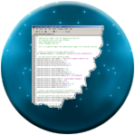
Single message - Receiving
Messaging
Handling message example:
<!-- File: http://remote.com/index.html -->
<body>
<p></p>
<script type="text/javascript">
window.onmessage = function(e){
if( e.origin == 'http://origin.com' )
document.querySelector('p').innerHTML += e.data +'<br>';
};
</script>
</body>

Slide 11
Channels
Messaging
Defines a private channel between two pages
Allows to retrieve a context
Facilitates communication
Managed by a MessageChannel object
Encapsulates two MessagePort objects
Represent current and remote context parts!

Slide 12
Channels
Messaging
To build your channel you need to:
Create a new MessageChannel object
Send a message with the following method:
postMessage(message, targetOrigin, ports)
This done, you can use your MessagePort objects on each side easily

Slide 13
<!-- File: http://origin.com/channel.html -->
<body>
<button disabled>Send</button>
<iframe src="http://remote.com"></iframe>
<p></p>
<script type="text/javascript">
var button = document.querySelector("button")
, frame = document.querySelector("iframe")
, i = 0
, channel = new MessageChannel()
, p = document.querySelector("p");
frame.onload = function() {
button.removeAttribute("disabled");
frame.contentWindow.postMessage("__SETUP__",
frame.src, [channel.port2]);
};
...
Channels - Example

Slide 14
...
button.onclick = function() {
channel.port1.postMessage(++i);
};
channel.port1.onmessage = function(e) {
if(e.data.__SETUP__)
d.innerHTML += e.data.__SETUP__ + "<br/>";
else if(e.data.number) {
i = parseInt(e.data.number);
d.innerHTML += i + "<br/>";
}
};
</script>
</body>
Channels - Example

Slide 15
Channels
Messaging
The MessageChannel interface has two MessagePort attributes: port1 and port2
The port2 attribute is sent on the remote document
The port1 attribute is used to retrieve messages

Slide 16
Channels
Messaging
The MessagePort interface expose a postMessage() function:
No need to send origin anymore
Just specify data you want to send

Slide 17
<!-- File: http://remote.com/channel.html -->
<body>
<p></p>
<script type="text/javascript">
var p = document.querySelector("p");
window.onmessage = function (e) {
if( e.origin == 'http://origin.com' ) {
if (e.data == "__SETUP__") {
port = e.ports[0];
port.onmessage = onPortMessage;
port.postMessage({
__SETUP__: "Connection established"
});
} else { alert("Bad request"); }
} else { alert("Bad origin"); }
}
...
Channels - Receiving

Slide 18
...
function onPortMessage(e) {
port.postMessage({
number: parseInt(e.data) + 1
});
p.innerHTML += e.data + "<br/>";
}
</script>
</body>
Channels - Receiving

Slide 19
Talking with modal dialogs
Messaging
Summon a dialog box – a new window
Available with the method:
window.showModalDialog()
Allows to return the result of the specified window in the main page

Slide 20
Talking with modal dialogs
Messaging
showModalDialog(uri, args, options)
uri: The resource address
args: Values to send to the remote window
options: Optional parameters defining the window
Returns the property “returnValue” of the remote window object

Slide 21
<!-- File: http://website.com/main.html -->
...
<body>
<p></p>
<script type="text/javascript">
window.onload = function(){
var samples = [3, 7];
var result = window.showModalDialog(
"http://website.com/remoteDialog.html",
samples, "dialogWidth:200;
dialogHeight:50; resizable:no;");
var p = document.querySelector("p");
p.textContent = "Result: " + result;
};
</script>
</body>
...
showModalDialog 1/2

Slide 22
<!-- File: http://website.com/remoteDialog.html -->
...
<body>
<p></p>
<script type="text/javascript">
document.write("Received : " +
window.dialogArguments);
var da = window.dialogArguments;
var addition = parseInt(da[0]) + parseInt(da[1]);
</script>
<input type="button" value="Send addition result"
onclick="window.returnValue = addition;
window.close();" />
</body>
...
showModalDialog 2/2

Slide 23


Questions ?

Slide 24

Web worker
HTML5 - New APIs

Slide 25
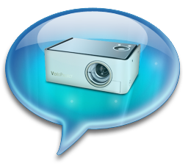
Web Worker
Presentation
Web Workers API allows you to run scripts in the background
Independently of any user interface scripts !
Useful for long-running scripts
Don’t need to manage yielding to keep the page responsive

Slide 26
Web Worker
Thread safety
Web Workers use real OS-level threads
As in other technologies, bad concurrency code can cause starvations, dead locks and other side effects

Slide 27
Web Worker
Thread safety
To limit these issues, the API provides :
A carefully controlled communication between threads
No access to non-thread safe components or the DOM

Slide 28
Web Worker
Worker interface
The core of the API is the Worker interface
It provides the following constructor :
Worker(scriptUrl) :
Creates a web worker that executes the script at the specified URL

Slide 29
Web Worker
Worker interface
It also provides the following methods :
postMessage(message) :
Sends a message to the worker's inner scope
terminate() :
Immediately terminates the worker without offers the worker an opportunity to finish its operations

Slide 30
Web Worker
Worker interface
And the following properties :
onmessage :
An event listener called when the worker return a message
onerror :
An event listener called when the worker return an error

Slide 31
Web Worker
Worker scope
Scripts executed by Workers have access to :
postMessage(message) function
Returns a message to the message handler of the main thread
onmessage property
Function which will receive messages sent when the worker object's postMessage() is called

Slide 32
Web Worker
Worker principle
Main thread
var worker = new Worker("worker.js");
worker.postMessage(message);
// Do something
worker.onmessage = function(event) {
// Do something
};
worker.js
...
onmessage = function(event) {
// Do something else
postMessage(message);
}

Slide 33
<ul id="result"></ul>
<script type="text/javascript">
var worker = new Worker('factorial.js');
worker.onmessage = function(event) {
var result = event.data;
var li = "<li>Factorial(" + result.n + "): ";
li += result.factorial + "</li>";
document.getElementById("result").innerHTML = li;
};
worker.postMessage(prompt("Number: "));
</script>
Example - index.html

Slide 34
function factorial(n, callback) {
if ((n == 0) || (n == 1)) callback(1);
else {
factorial(n - 1, function(result) {
postMessage({ n: (n - 1), factorial: result });
result *= n;
setTimeout(function() { callback(result) }, 2000);
});
}
}
self.onmessage = function(event) {
factorial(event.data, function(result) {
postMessage({ n: event.data, factorial: result });
});
}
Example - factoral.js

Slide 35
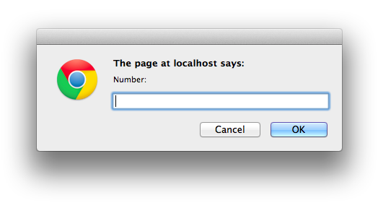
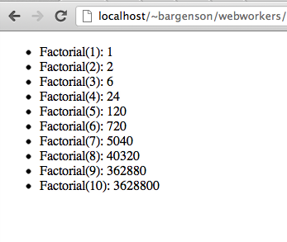
Web Worker
Example

Slide 36
Questions ?

Slide 37
Web Worker
Exercise (1/4)
During this exercise, we will develop a simple page which will
Fetch tweets about SUPINFO every 10 seconds
Display them

Slide 38
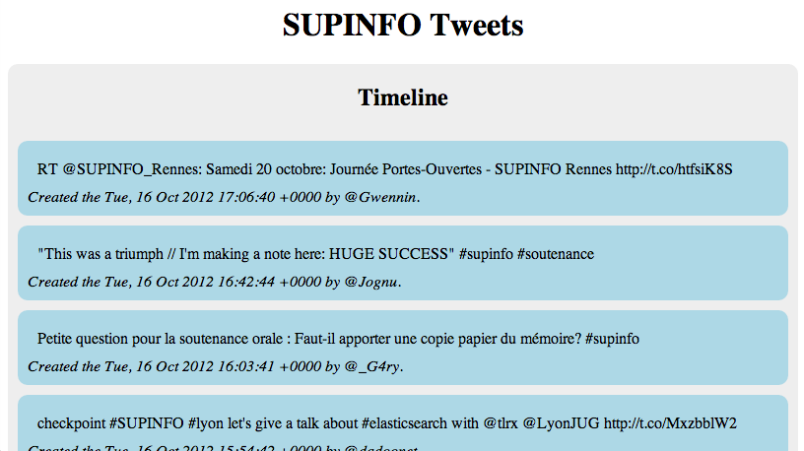
Web Worker
Exercise (2/4)

Slide 39
Web Worker
Exercise (3/4)
The script fetching the tweets must be execute by a WebWorker
You can retrieve the tweets about SUPINFO thanks to this URI :
http://search.twitter.com/search.json?q=SUPINFO&since_id=<LAST_TWEET_ID>
Notes:
LAST_TWEET_ID: must be the ID of the last tweet your received

Slide 40
Web Worker
Exercise (4/4)
Your script must check every 10 seconds if new tweets are available
If there are, you must send them to the UI thread to display them

Slide 41
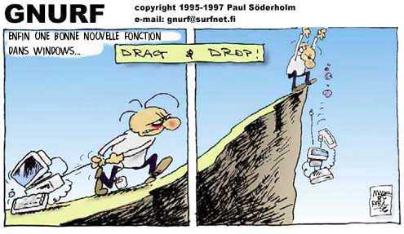
Drag & drop
HTML5 - New APIs

Slide 42
Drag & Drop
Presentation
Drag and drop is a very common feature
"grab" an object and drag it to a different location
In HTML5, drag and drop is part of the standard, and any element can be draggable

Slide 43
Drag & Drop
Draggable
To make an element draggable is very simple :
Give the element a draggable attribute
Set an event listener for dragstart event
<p>What fruits do you like?</p>
<ol>
<li draggable="true"> Apples </li>
<li draggable="true"> Oranges </li>
<li draggable="true"> Pears </li>
</ol>

Slide 44
Drag & Drop
Draggable
Handler :
var fruits = document.querySelectorAll("li[draggable]");
var fruit = null;
for (var i = 0; i < fruits.length; i++) {
fruit = fruits[i];
fruit.addEventListener("dragstart", function(event) {
console.log("dragstart");
});
};

Slide 45
Drag & Drop
Dropzone
To make an element accept a drop :
Give the element a dropzone attribute
Set an event listener for dragover event and cancel the event
Otherwise, no drop event will be triggered
Set an event listener for drop event

Slide 46
Drag & Drop
Dropzone
Example :
<ol dropzone="move string:text/x-example" ondragover="event.preventDefault()" ondrop="dropHandler(event)">
</ol>

Slide 47
Drag & Drop
Dropzone
The dropzone attribute specifies
What kind of data to accept
string:text/plain
file:image/png
...
What kind of feedback to give
move
copy
…

Slide 48
Drag & Drop
Dropzone
Instead of using the dropzone attribute, you can use :
A dragenter event handler
To report whether or not the drop target is to accept the drop
A dragover event handler
To specify what feedback is to be shown to the user

Slide 49
Drag & Drop
Dropzone
Example:
var zone = document.querySelector("ol[dropzone]");
zone.addEventListener("dragover", function(event) { ... });
zone.addEventListener("dragenter", function(event) { ... });
zone.addEventListener("dragleave", function(event) { ... });
zone.addEventListener("drop", function(event) { ... });

Slide 50
Drag & Drop
Data Transfer
DataTransfer object is used to transfer information from the draggable element to the dropzone
Accessible from the event parameter inside your handlers
fruit.addEventListener("dragstart", function(event) {
var dataTransfer = event.dataTransfer;
});

Slide 51
Drag & Drop
Data Transfer
The two main methods of the DataTransfer interface are :
getData(type)
Retrieves the data for a given type, or an empty string if does not exist
setData(type, data)
Sets the data for a given type

Slide 52
Drag & Drop
Data Transfer - Example
...
fruit.addEventListener("dragstart", function(event) {
event.dataTransfer.setData("text", this.id);
});
...
zone.addEventListener("dragover", function(event) {
event.preventDefault(); // allows us to drop
});
zone.addEventListener("drop", function(event) {
var fruitId = event.dataTransfer.getData("text");
// Append the fruit to the dropzone
});

Slide 53
Questions ?

Slide 54
Drag & Drop
Exercise (1/2)
Update your SUPINFO Tweets page :
Add a new area for your favorite tweets
Make it a drop zone
Make the timeline tweets draggable

Slide 55
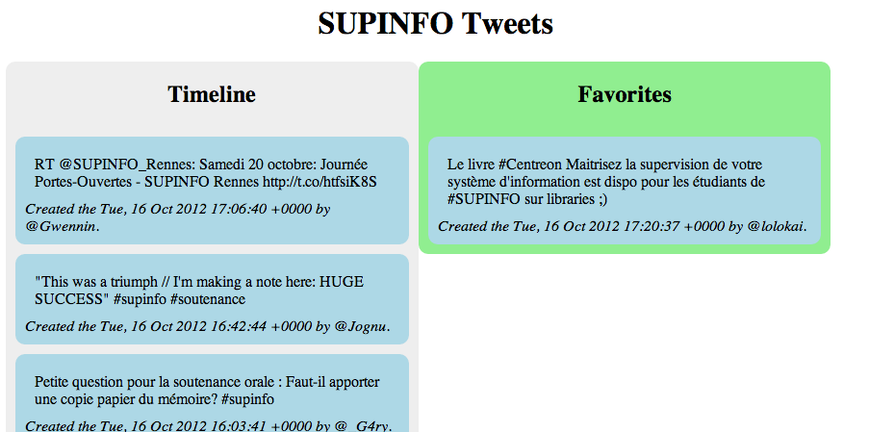
Drag & Drop
Exercise (2/2)

Slide 56

geolocation
HTML5 - New APIs

Slide 57
Geolocation
Presentation
The new Geolocation API defines a high-level interface to location information
The API itself is agnostic of the underlying location information sources
Can be GPS, location inferred from network signals as well as user input

Slide 58
Geolocation
Presentation
The API is designed to enable
"one-shot" position requests
repeated position updates
Location information is represented by latitude and longitude coordinates

Slide 59
Geolocation
One-shot position request
The Geolocation interface expose the following method to do that:
getCurrentPosition(callback)
The callback function take the user position as argument

Slide 60
Geolocation
One-shot position request
Example :
navigator.geolocation.getCurrentPosition( function(position){
console.log("Latitude: " + position.coords.latitude);
console.log("Longitude: " + position.coords.longitude);
});

Slide 61
Geolocation
Repeated position updates
The Geolocation interface expose also the following methods :
watchPosition(callback, errorHandler)
Request repeated updates and return a watcher ID
clearWatch(watchId)
Cancel the updates for a given watcher ID

Slide 62
Geolocation
Repeated position updates
Example :
var geolocation = navigator.geolocation
, watchId = geolocation.watchPosition(updateLocation, handleError);
function updateLocation(position) { // Do something }
function handleError(error) { // Display an error message }
document.getElementById("cancelButton").onclick = function() {
navigator.geolocation.clearWatch(watchId);
}

Slide 63
Questions ?

Slide 64
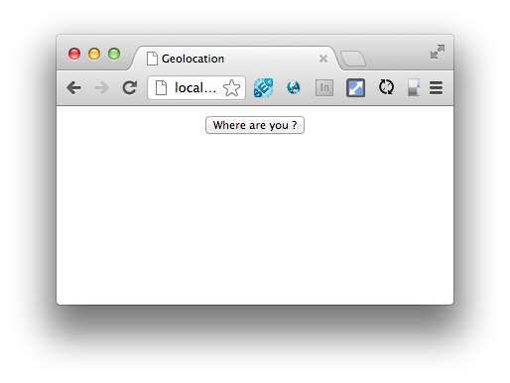
Geolocation
Exercise (1/3)
Create a new page with a simple button as follow :

Slide 65
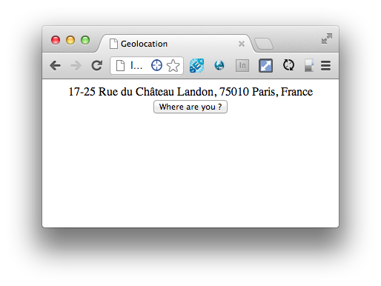
Geolocation
Exercise (2/3)
When the user clicks on the button, you have to display his address :

Slide 66
Geolocation
Exercise (3/3)
To convert coordinates to address, you can use the Google Maps Geocoder API:
https://developers.google.com/maps/documentation/javascript/geocoding

Slide 67


